Slide 1
Non-Homogeneous Recurrence Relations
Jorge A. Cobb
The University of Texas at Dallas

Slide 2
Linear nonhomogeneous recurrence relations
Still constant coefficients
Non-homogeneous:
  We now have one or more additional terms which depend on n but not on previous values of a_{n}
Examples:
  a_{n} = a_{n-1} + n, a_{n} = a_{n-2} + n² + 1
General form:
  a_{n} = c₁a_{n-1} + c₂a_{n-2} + ... + c_{k}a_{n-k} + F(n)

Slide 3
Associated homogeneous recurrence relation
If we ignore F(n) in the previous form, we obtain the homogeneous recurrence relation associated with the non-homogeneous one we are trying to solve
Theorem 5: If {a_{n}^{(p)}} is a particular solution for a nonhomogeneous recurrence relation, then all solutions are of the form {a_{n}^{(p)}}+{a_{n}^{(h)}}, where {a_{n}^{(h)}} is a solution of the associated homogeneous recurrence relation

Slide 4
Proving Theorem 5
Suppose {a_{n}^{(p)}} is such a particular solution (for non-homogeneous) and {b_{n}} is another solution (also for n.h.)
a_{n}^{(p)} = c₁a_{n-1}^{(p)} + c₂a_{n-2}^{(p)} + ... + c_{k}a_{n-k}^{(p)} + F(n)
b_{n} = c₁b_{n-1} + c₂b_{n-2} + ... + c_{k}b_{n-k} + F(n)
By subtracting the first equation from the second,
b_{n} – a_{n}^{(p)} = c₁(b_{n-1} – a_{n-1}^{(p)}) + ... + c_{k}(b_{n-k} – a_{n-k}^{(p)})
{b_{n} – a_{n}^{(p)}} is a solution of the associated homogeneous recurrence relation.
Hence, {b_{n}} = {a_{n}^{(p)}} + ({b_{n}} - {a_{n}^{(p)}}), which is what we want

Slide 5
Finding solutions
Finding a particular solution is the tricky part
There are general solutions for certain classes of functions F(n) but not for every possible F(n)
Sometimes, we have to guess on possible forms based on F(n)

Slide 6
Example
a_{n} = 2a_{n-1} + 2n, a₁ = 6
Any homogeneous solution is
  a_{n}^{(h)} = b2^{n} for some constant b
For a particular solution, guess
Why guess? If it works, it might lead us to a general theorem
a_{n}^{(p)} = cn + d

Slide 7
Continued …
a_{n}^{(p)}
= cn + d (from guess)
= 2a_{n-1}^{(p)} + 2n (from recurrence relation)
= 2(c(n-1) + d) + 2n (from guess of a_{n-1})
= (2c + 2)n – 2c + 2d
cn + d = (2c + 2)n – 2c + 2d (all of the above together)
0 = (c + 2)n + (d – 2c) (can we make it = 0 for all n????)
c + 2 = 0 ⇔ c = -2
d – 2c = 0 ⇔ d + 4 = 0 ⇔ d = -4

Slide 8
Example continued
We determined that any solution of the recurrence relation is of the form
a_{n} = – 2n – 4 + b2^{n}
What is b? (for our desired solution)
With a₁ = 6, we have
a₁ = 6 = – 2·1 – 4 + b2¹ = – 6 + 2b
  b = 6
a_{n} = – 2n – 4 + 6·2^{n} is our desired solution.

Slide 9
Polynomial and exponential F(n)
Theorem 6: If the function F(n) is of the form F(n) = (β_{t}n^{t} + β_{t-1}n^{t-1} + ... + β₀)s^{n}, then
  If s is not a root of the characteristic equation of the associated homogeneous recurrence relation, there is a solution of the form
  (p_{t}n^{t} + p_{t-1}n^{t-1} + ... + p₀)s^{n}
  If s is such a root with multiplicity m, then there is a solution of the form
  n^{m}(p_{t}n^{t} + p_{t-1}n^{t-1} + ... + p₀)s^{n}

Slide 10
Examples
a_{n} = 6a_{n-1} – 9a_{n-2} + F(n)
Characteristic eq: r² – 6r + 9 = (r - 3)²
Root r = 3, multiplicity m = 2
We consider cases where F(n) = Q(n)s^{n}, for some polynomial Q

Slide 11
Examples (continued)
Assume F(n) = 3^{n}
  F(n) = Q(n)s^{n} = 1⋅3^{n}
  degree t = 0, s = 3 is a root of mult 2
  Particular solution is of the form
  n^{m}(p_{t}n^{t} + p_{t-1}n^{t-1} + ... + p₀)s^{n}
  n²(p₀)3^{n}
Assume F(n) = n3^{n}
  degree t = 1, s = 3 is a root of mult 2
  Particular solution is of the form
    n^{m}(p_{t}n^{t} + p_{t-1}n^{t-1} + ... + p₀)s^{n}
    n²(p₁n¹ + p₀)3^{n}

Slide 12
Examples (continued)
Assume F(n) = n²2^{n}
  F(n) = Q(n)s^{n} = n²2^{n}
  degree t = 2, s = 2 is not a root
  Particular solution is of the form
    (p_{t}n^{t} + p_{t-1}n^{t-1} + ... + p₀)s^{n}
    (p₂n² + p₁n + p₀)2^{n}
Assume F(n) = n²3^{n}
  F(n) = Q(n)s^{n} = n²3^{n}
  degree t = 2, s = 3 is a root of multiplicity 2
  Particular solution is of the form
    n^{m}(p_{t}n^{t} + p_{t-1}n^{t-1} + ... + p₀)s^{n}
    n²(p₂n² + p₁n + p₀)3^{n}

Slide 13
Sum of integers
a_{n} = 1 + 2 + ... + (n+1)
Recurrence relation:
Associated homogeneous RR:
The homogeneous RR’s characteristic equation is
The homogenous solution is thus of the form
a₀ = 1, so ..
a_{n} = a_{n-1} + (n+1)
a_{n} = a_{n-1}
r - 1 = 0
a_{n} = b·1^{n} = b
nope, you can’t find b yet ☺

Slide 14
Sum of integers
a_{n} = a_{n-1} + (n + 1), F(n) = (n + 1)
F(n) = (β_{t}n^{t} + β_{t-1}n^{t-1} + ... + β₀)s^{n}
F(n) = (n + 1) = (n + 1)·1^{n}
  thus: t = 1, β₁ = 1, β₀ = 1, s = 1
Recall that the homogeneous RR characteristic equation has root = 1 with multiplicity 1
  s is thus a characteristic root with multiplicity 1

Slide 15
Sum of integers continued
A particular solution is of the form
  n^{m}(p_{t}n^{t} + p_{t-1}n^{t-1} + ... + p₀)s^{n} (recall F(n) = n+1)
a_{n} = n¹(p₁n + p₀)1^{n} = p₁n² + p₀n
a_{n} = a_{n-1} + n + 1
p₁n² + p₀n
= a_{n-1} + n + 1
= p₁(n-1)² + p₀(n-1) + n + 1
= p₁(n² – 2n + 1) + p₀(n-1) + n + 1
= p₁n² + (-2p₁ + p₀ + 1)n + (p₁-p₀) + 1
(-2p₁ + 1)n + (p₁-p₀) + 1 = 0

Slide 16
Sum of integers continued
(-2p₁ + 1)n + (p₁ - p₀) + 1 = 0
For this to be true, -2p₁ + 1 = 0 ⇔ p₁ = 1/2
(p₁ - p₀) + 1 = 0
and p₀ = p₁ + 1 = 3/2

Slide 17
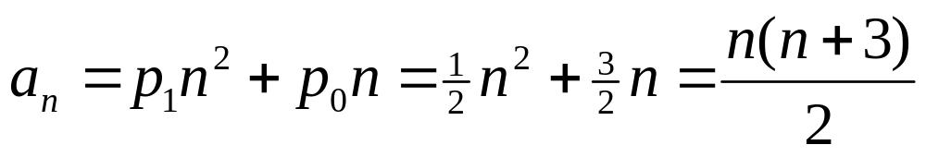
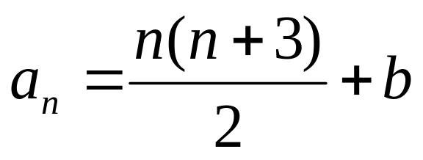
Sum of integers continued
Therefore the particular solution is
and all solutions are of the form
From the initial condition a₀=1, we obtain
a₀ = 1 = 0·(0 + 3)/2 + b, so b=1

